Slide 1
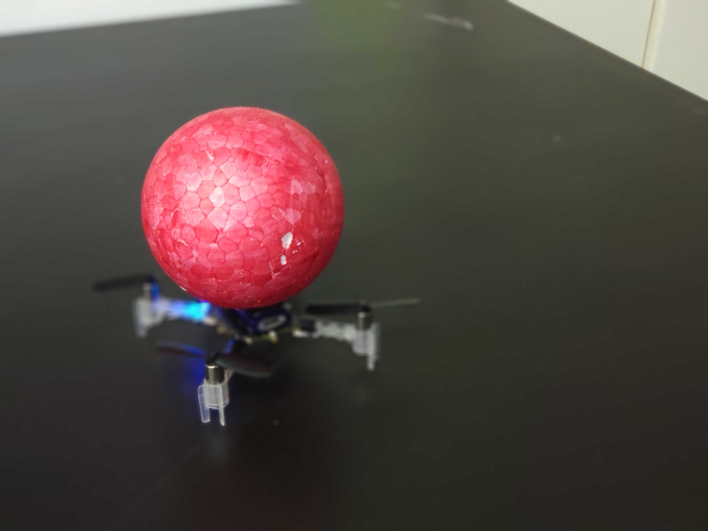
Autonomous Nano-Drones Indoor Navigation System Based On Depth-RGB Image Processing
Project Number: 18-1-1-1622
By: Saar Adutler, Mor Yagel Advisor: Yonatan Mandel
Project Carried Out at Tel Aviv University, 2019
Project’s Presentation 11.6.2019

Slide 2
Motivation
Drones developing has been a major focus in recent years in both industry and research for various purposes:
Military
Policing and Security
Agriculture
Security

Slide 3
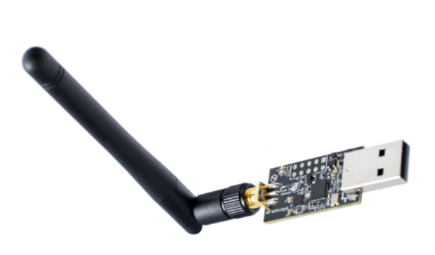
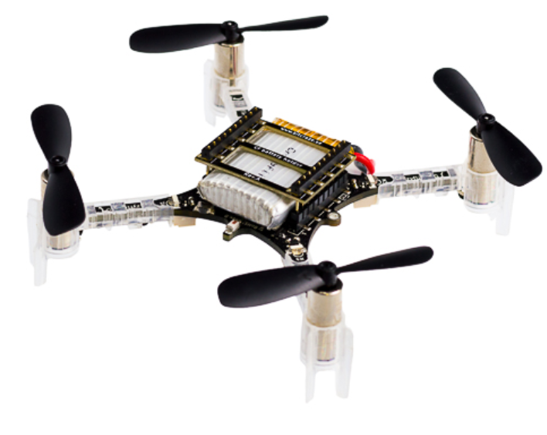
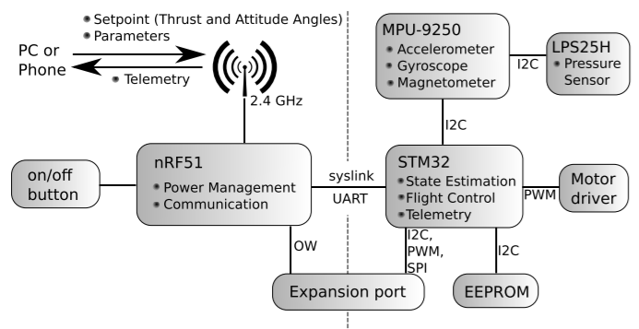
System’s Components – CrazyFlie
Bitcraze Crazyflie 2.0 platform
An open-source, open-hardware Nano quadcopter
Small size (92mm diagonal rotor-to-rotor) and light weight (29g)
Controlled from a PC using “CrazyRadio PA” USB dongle (2.4GHz)

Slide 4
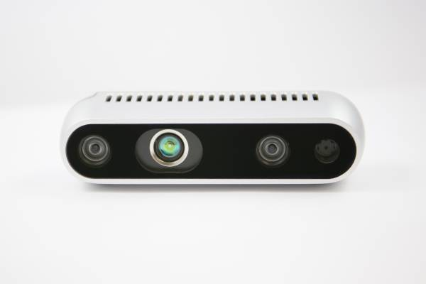
System’s Components – Intel RealSense D435
USB powered
Small and light-weight
Stereo depth sensors
Infrared projector
RGB module
Range up to 10m

Slide 5

ROS Based System
A collection of software frameworks for robot software development
Supported by Linux Ubuntu
Crazyflie_ros
Realsense2_camera

Slide 6
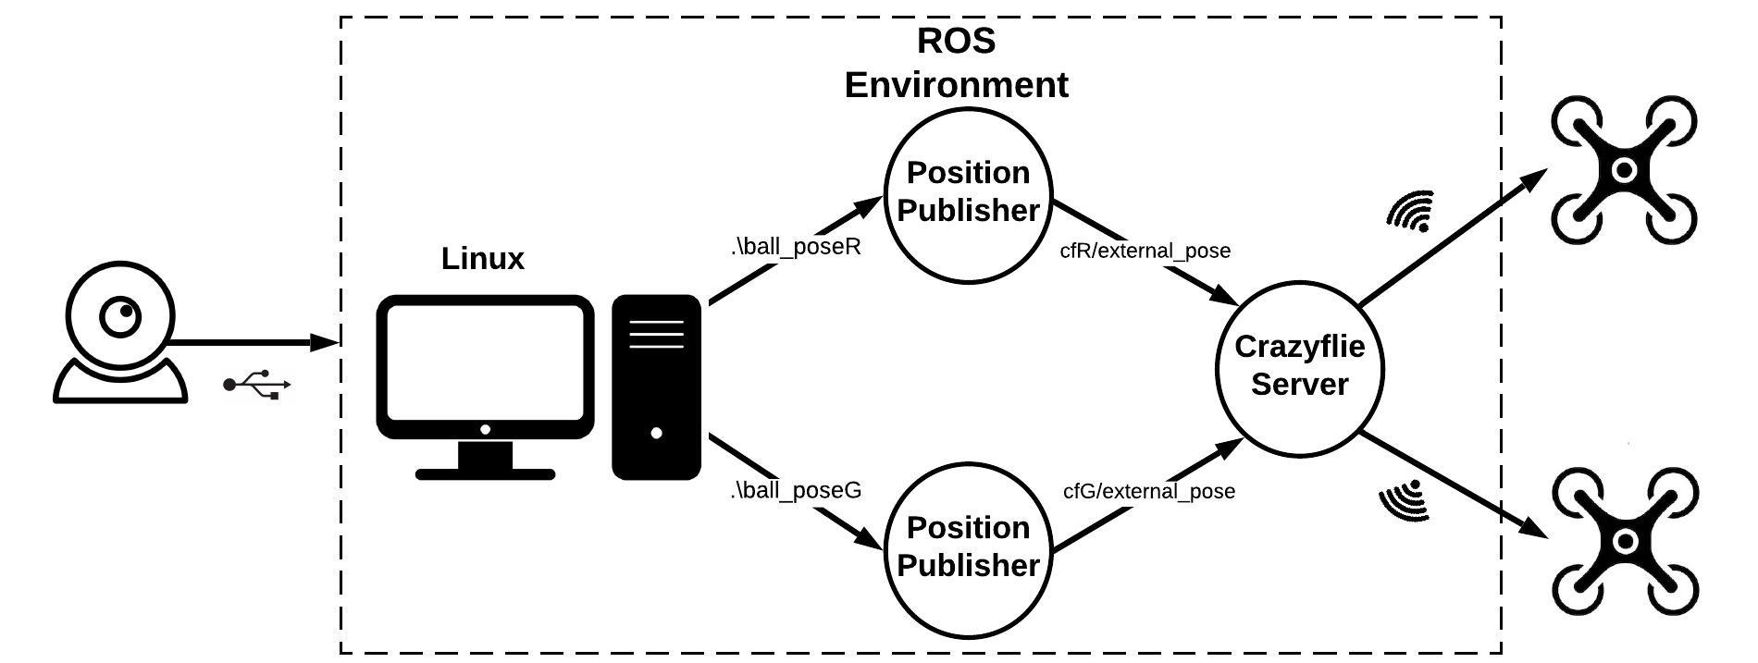

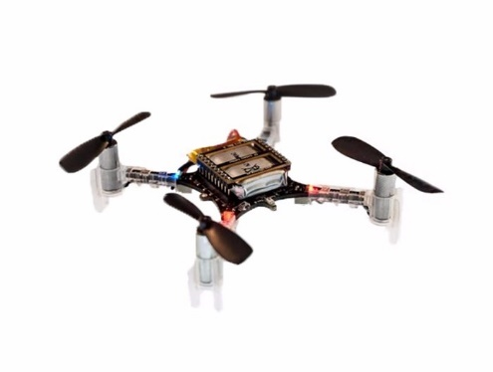
System’s Final Architecture
ROS - Robotic Operating System
A collection of software frameworks for robot software development
Intel RealSense D435
USB-powered camera that includes pair of depth sensors, an RGB sensor and an infrared projector.
Crazyflie 2.0
Lightweight, open source flying development platform based on a nano quadcopter

Slide 7
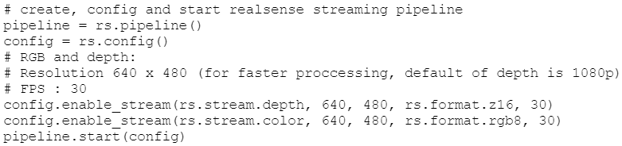
Code Example – findMyBall

Slide 8
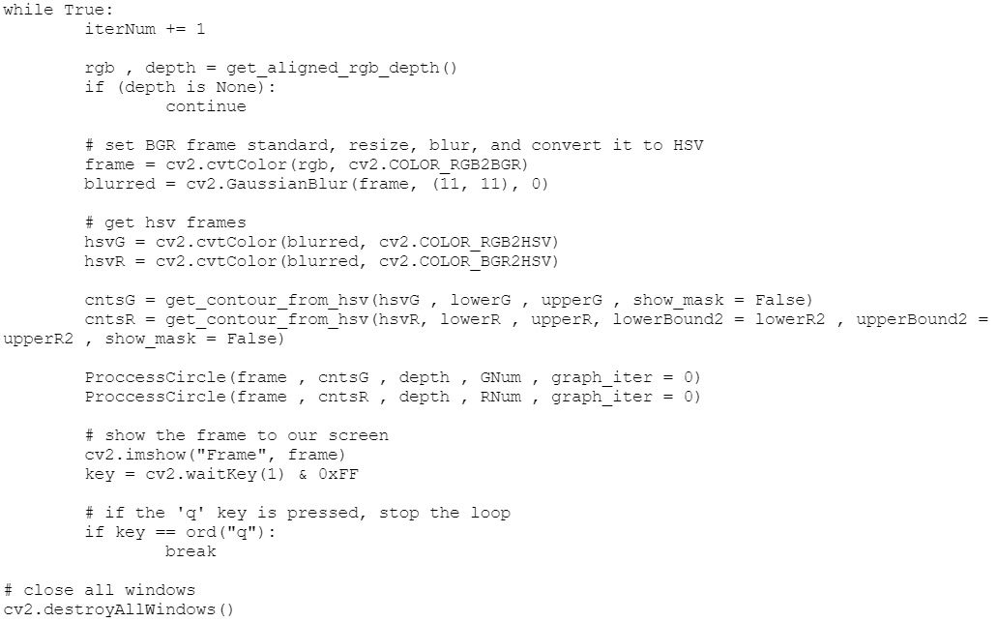
Code Example – findMyBall

Slide 9
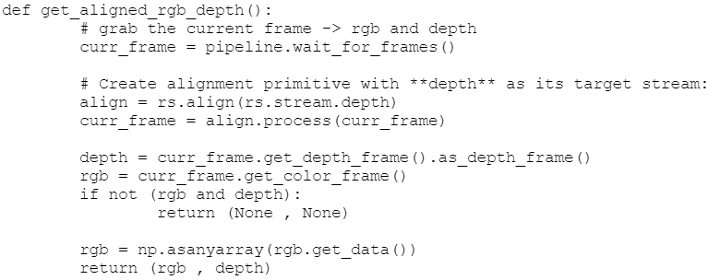
Code Example – findMyBall

Slide 10
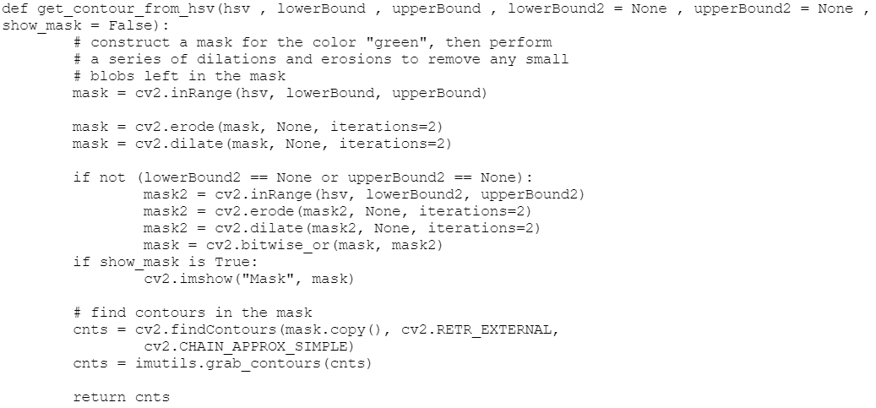
Code Example – findMyBall

Slide 11
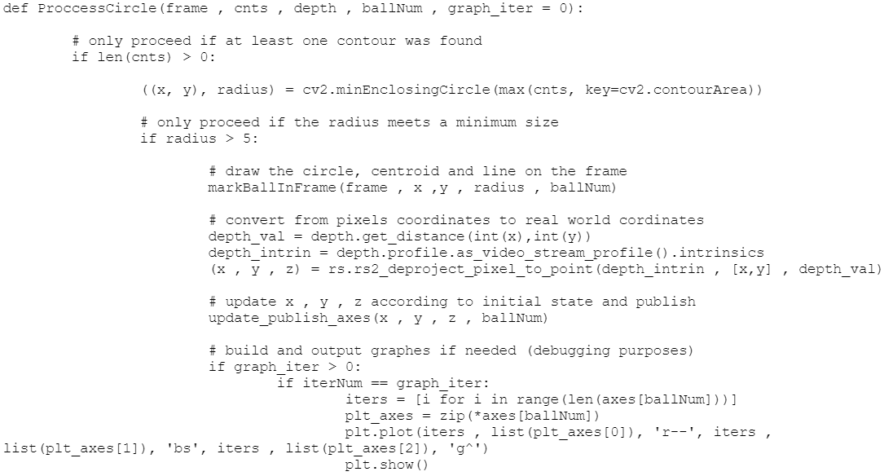
Code Example – findMyBall

Slide 12
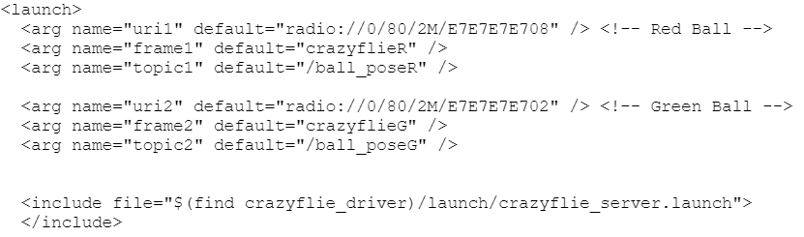
Code Example – Launch file

Slide 13
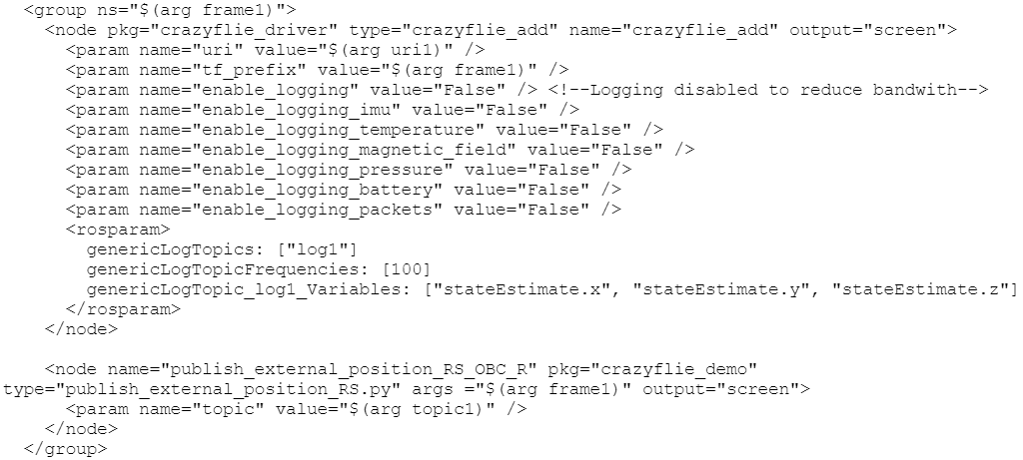
Code Example – Launch file

Slide 14
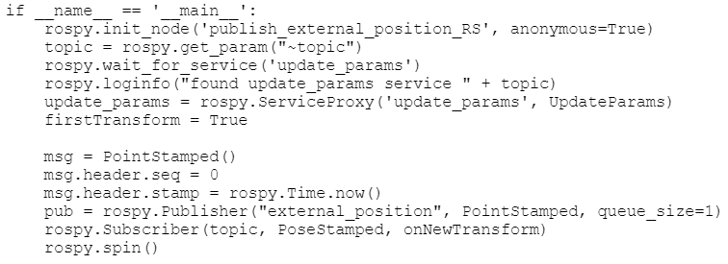
Code Example – Publisher file

Slide 15
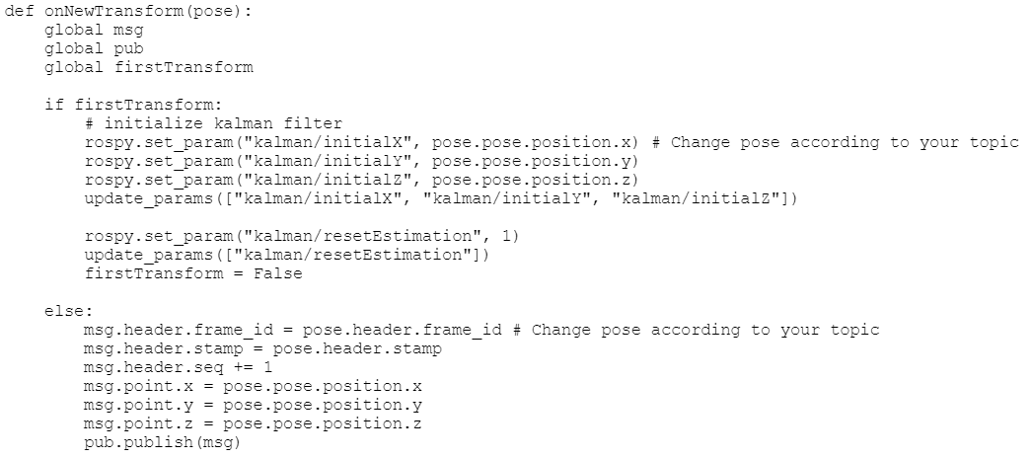
Code Example – Publisher file

Slide 16
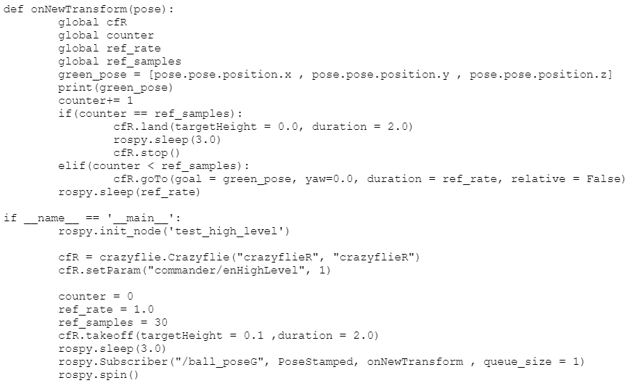
Code Example – High Level Script

Slide 17
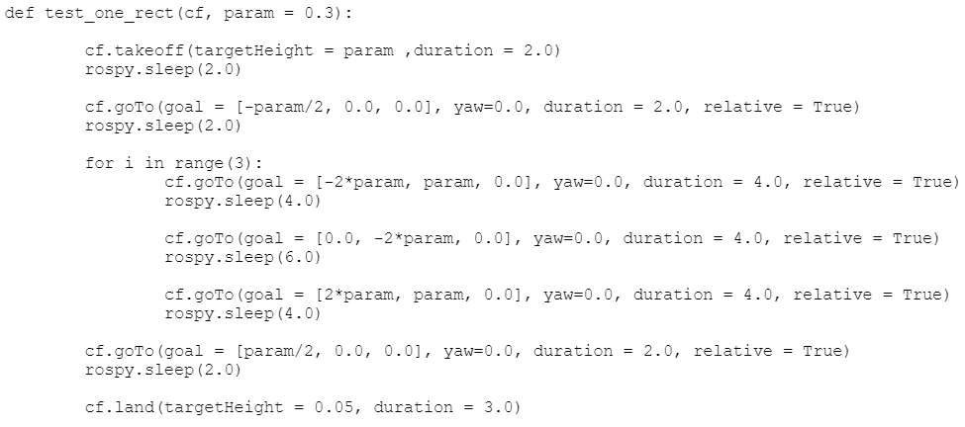
Code Example – High Level Script

Slide 18
Main Challenges During Development
Integration – System of Systems
ROS Environment
OpenCV - Image processing
Open Source
Debugging

Slide 19
Project’s Products
Stabilized Hovering
Way-point Navigation
“Swarm” synchronized flight
Target Following

Slide 20
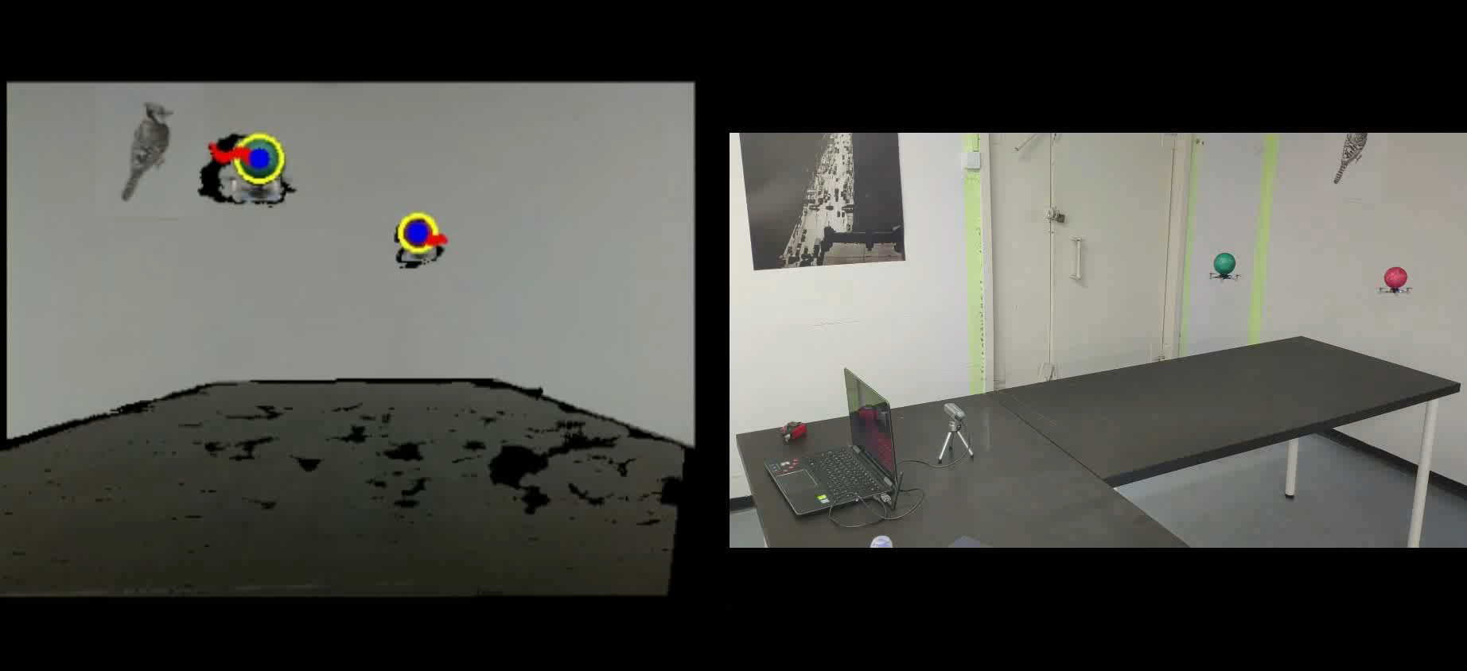
Project’s Products
Stabilized Hovering
Way-point Navigation
“Swarm” synchronized flight
Target Following

Slide 21
Future Work
Alternative tracking algorithm (i.e. ML Based)
Low level - Embedded Sensors for collision avoidance
Use a longer range depth camera for full room’s mapping
Extend support for multiple depth cameras simultaneously (can provide multiple rooms’ mapping)

Slide 22
THANKS!
😉
Any questions?

